Slide 1
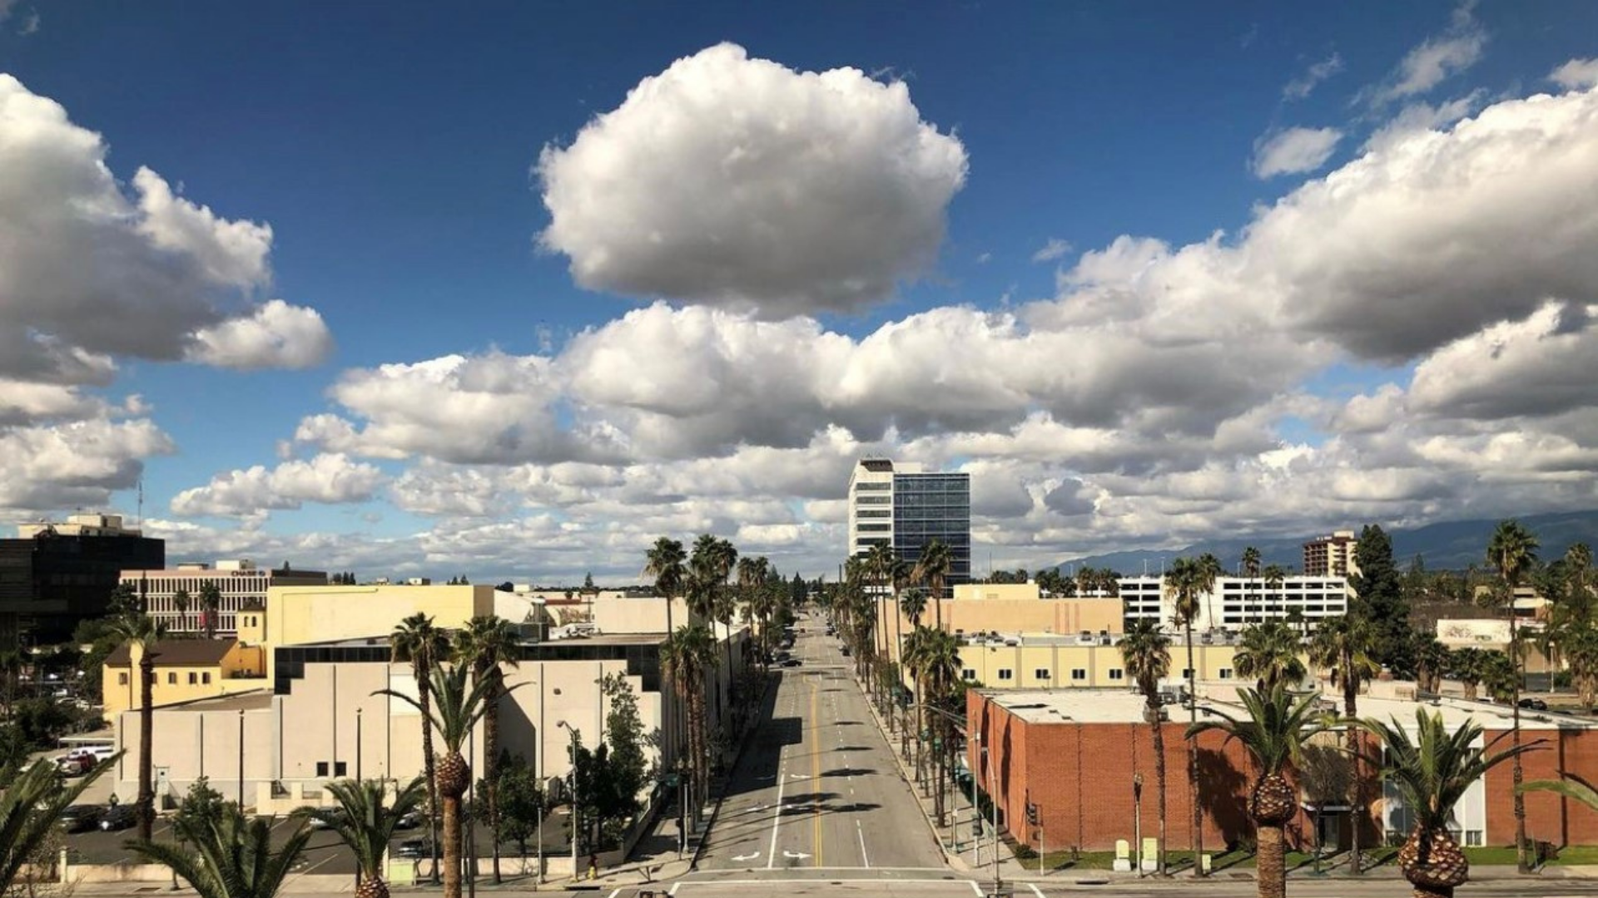


Behavioral Health and Wellness in 2023:
A Roadmap for Success!
Aging and Adult Services Public Guardian
www.SBCounty.gov/daas

Slide 2

PRESENTERS
KRYSTLE ROWE, PhD, LMFT, MBA, Deputy Director
RUBEN ROBLES, LMFT, Mental Health Program Manager I

Slide 3
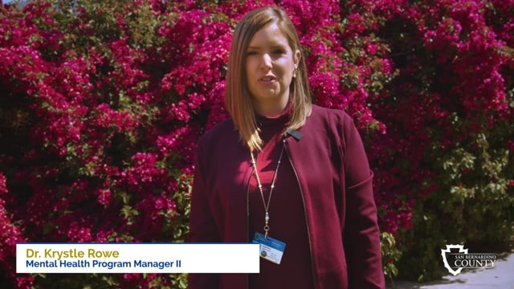
Age Wise program video. Available online at https://vimeo.com/575974618

Slide 4
WHAT WE DO
We assist older adults by:
Offering field-based behavioral health and wellness therapy
Providing intensive case management
Completing forms and applications
Locating and connecting to resources
‘No wrong door’ approach
Addressing the stigma of participating in the behavioral health and wellness system

Slide 5




Program Achievement Awards
2021
2021
2022
Human Services Achievement Award
Home and Community Based Services Category
Human Services Achievement Award
Age Wise’s 24/7 Hotline Expands Seniors’ Access to Vital Services
San Bernardino County Age Wise Program
Age Wise Home and Community Based Mental Health Services Expands Access for Seniors
“The value of an idea lies in the using of it.“
Thomas Edison (1847 – 1931), Inventor

Slide 6

Program Achievement Awards continued
2023
Age Wise Fall Prevention Program
Age Wise Learning Collaborative with Lifestyle Medical
Robotic Pet Initiative
Telehealth Home-Based Behavioral Health Care for Older Adults
Human Services Achievement Awards
“There’s a way to do it better. Find it.“
Thomas Edison (1847 – 1931), Inventor

Slide 7


COLLABORATIONS AND PARTNERSHIPS
Adult Protective Services (APS)
Aging and Disability Resource Center (ADRC)
Department of Behavioral Health (DBH)
In-Home Supportive Services (IHSS)
LifeStyle Medical
Multipurpose Senior Services Program (MSSP)
Nutrition Services
Office of the Public Guardian (OPG)
Senior Information and Assistance (SIA)

Slide 8
Theoretical Concept | Systems Theory and Logic Model
How
Outcomes
What the Age Wise
Program does
Age Wise
clientele will show
Resources/ Inputs
DBH funding $3 million
Clinical and paraprofessional staff
Educational training
Two field-based clinics
Medi-Cal or eligible for Medi-Cal
Activities
Referrals and marketing
Behavioral health therapy/ counseling
Case management services
Occupational Therapy
Full-Service Partnership
Outputs
Work toward independent, sole-functioning older adults with little need for assistance to obtain community resources to sustain their autonomy.
Target Population
Number of older adults age 59+ who voluntarily participate in the Age Wise Program.
Short-term
Age Wise Program clientele become knowledgeable of community resources, goals of therapy and how to stride toward independent living.
Intermediate
Age Wise Program clientele
implement and exercise clinical changes, use the skills and resources taught to increase self-autonomy.
Long-term
Age Wise Program clientele
will sustain their changes so they can age in place, including a focus on residing in appropriate housing.
Attitudes
Behavior
Condition
Program
Results
External Influences (Sphere of Influence)
Client’s demeanor and/or attitude to participate in treatment, relocating, chronic medical
conditions that progressively worsen, and pass away unexpectedly.

Slide 9
Building Your Model
Internal and External Supports
  Trainings
    Motivational Interviewing
    Single Session Therapy
    Grief
    Trauma
    Geriatrics
Medical
OTHER RESOURCES
Family members
Neighbors
Community relationships
First responders
Peer and Family Advocate
    Primary Care Physician
    DBH – Psychiatry
    Lifestyle Medical
Office Assistants
Older Adult Client
Mental Health Specialists
and
Social Worker
Clinicians
and Occupational Therapist
Leadership
Collaborations
  Program Manager
  Clinic Supervisor
APS
ADRC
IHSS
MSSP
SIA
Nutrition

Slide 10
PRIMARY CLIENT DIAGNOSIS
Fiscal Year (FY) 2021/2022
Depressive Disorders 61%
Bipolar Disorder 16%
Psychosis 18%
Anxiety Disorders 4%
Other 1%
San Bernardino County Department of Behavioral Health
Mental Health Services Act (MHSA) Annual Update, Fiscal Year 2021/2022

Slide 11

Trainings
‘No Wrong Door’ Key Principles Certificate
Adult Needs and Strengths Assessment (ANSA)
Mental Health First Aid
Suicide & Self Harm Prevention
Law and Ethics
Cultural Competency
Telehealth Certification Training
Listen – Empathize – Agree – Partner (LEAP)
Single Session Therapy
Motivational Interviewing
Community Resiliency Model
Trauma Resiliency Model
Certified Grief Counseling Specialist
Certified Fall Prevention Specialist

Slide 12

PROGRAM FUNDING
LARGER HEADLINE
Mental Health Services Act (MHSA)
Medi-Cal Provider
Grant Funding

Slide 13


Outcomes
Skill Development to Age in Place
Mental Health Services Act (MHSA)
Total Clients: 104
Total Clients: 120
Total Clients: 105
Goal 1
Maintained low or reduced risk of subjective suffering
Goal 2
Remained
in safe housing
Goal 3
Stable and able to seek resources on their own
Goal 4
Linked to
primary care
provider
Notes:
Total Number of clients in FY 19/20 = 104
Total Number of clients in FY 20/21 = 120

Slide 14
Outcomes
Mental Health Services Act (MHSA)
Reduce Frequency of Emergency Room (ER) Visits and Unnecessary Hospitalizations
96%
100%
99%
100%
80%
60%
40%
20%
0%
Total Clients: 104
Total Clients: 120
11%
Total Clients: 105
4%
1%
0%
7%
3%
2%
0%
0%
No hospitalizations related to behavioral health
Psychiatric
hospitalizations
Medical
hospitalizations
High use ER
Notes:
Total Number of clients in FY 19/20 = 104
Total Number of clients in FY 20/21 = 120

Slide 15

QUESTIONS?

Slide 16

CONTACT US
AGE WISE PROGRAM
KRYSTLE ROWE, PHD, LMFT, MBA
Deputy Director
(909) 891-3870
Krystle.Rowe@pg.sbcounty.gov
RUBEN ROBLES, LMFT
Mental Health Program Manager I
(909) 798-8527
Ruben.Robles@hss.sbcounty.gov

Slide 17

THANK YOU

