Slide 1
Integration & Innovation in Delivery of Services to Veterans
Nevada County Veterans Services
Presented by David West II
Nevada County Veterans Services Officer

Slide 2
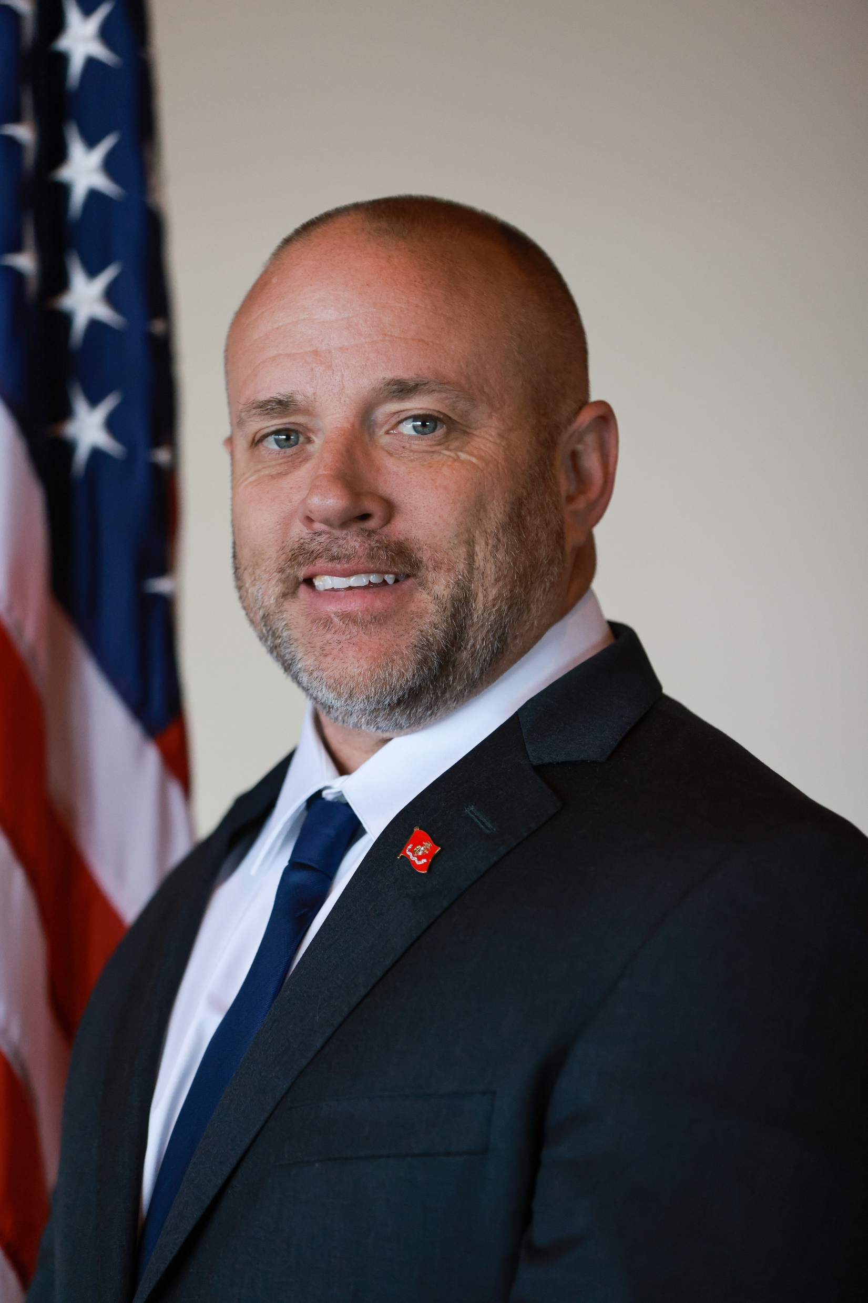
About Me
Former Marine
Began career at Nevada County in 2018

Slide 3
Why are you here today?

Slide 4
Learning Objectives
Integration of services within DSS
Innovation in delivering services
Reduce stigma in providing services to veterans

Slide 5
What is a CVSO?
First POC for veterans when accessing benefits
Recognized as experts with assisting veterans obtain benefits
We are much more

Slide 6
Our Leadership Philosophy
Create a culture of learning
Foster leadership at all levels
Encourage growth, learning, & pursuit of excellence

Slide 7
Integration within DSS
Upgraded staff positions to HHS I/II
VSO staff participate in department specific training
Allows for focus on providing hollistic services

Slide 8
Collaboration with Eligibility
Focused on CA’s Medi-Cal Cost Avoidance Program
Increased revenue by $40,000 annually
Decreased eligibility staff workload
Improved services between departments

Slide 9
Innovation of Services
We recruit directly from DSS
Visit clients where they are
We submit applications for Medi-Cal/CalFresh
Heart-centered approach to providing services

Slide 10
Innovation in Delivering Services
Online appointment schedular
Apply online for certain benefits
Digital business cards

Slide 11
Reducing Stigma
Many do not view themselves as a “Veteran”
Were told they were not eligible for benefits at discharge
Many unaware how new legislation impacts them
Women veterans require different outreach efforts
Most view eligibility benefits as a “handout”

Slide 12
Reducing Stigma
Lobby is veteran specific
Resource closet
Collaboration with all agencies in building
We offer drinks, food, and TV

Slide 13
Rethinking Mental Health
Collaboration to develop alternative outlets
Contract for mental health services
Suicide Prevention

Slide 14
Collaboration to Reduce Veterans Homelessness
2020 entered the “Last Mile”
Data drives our decisions
50+ veterans have successfully been housed

Slide 15
Integration within HR
Developed Intern Program
Partner in the ArmyPays program
Actively participating in the DoDs SkillBridge Program
Received the DoL “Platinum Award” through participation in its Hire Vets Program

Slide 17
Additional Steps to Serve Our Veterans
Process of setting new goals
Collaborated with local agencies to submit different grants
Working to expand engagement

Slide 19
Questions?
“Homeless and at-risk veterans need more than just shelter. We must give them the tools to empower themselves and reclaim the self-worth and dignity which comes from occupying a place in the American dream. It is a dream they fought so hard to defend for the rest of us.”
- Maria Cuomo Cole

