Slide 1
CWDA Webinar:
Working with Immigrant Families

Slide 2
Presented By
Welcome & Overview - Assmaa Elayyat, CWDA
CWDA Tool Kit - Megan Gamble, CWDA
Legal Resources - Jen Flory, Western Center for Law & Poverty
Assisting Immigrant Families – Gabrielle Lessard, NILC
2

Slide 3
Special Thanks!
Special thanks to the Counties & Organizations for their partnership and to the California Health Care Foundation for supporting this effort.
Alameda, Kern, Marin, Merced, Riverside, Sacramento, San Francisco, San Mateo, and Santa Clara
National Immigration Law Center, Western Center on Law and Poverty, The California Endowment, CA Immigration Policy Center, Immigrant Legal Resource Center, CA Association of Public Hospitals, Santa Clara Valley Health and Hospital System, CA Coverage and Health Initiatives, CA Primary Care Association, The Children’s Partnership, CDSS & DHCS
3
3
Notes:
3

Slide 4
Overview
CWDA has partnered with the California Health Care Foundation (CHCF) to work on an immigration project with the objective to enhance and develop resources the counties have in order to assist immigrant customers and build collaborative partnerships between counties and key organizations that work with immigrants.
4

Slide 5
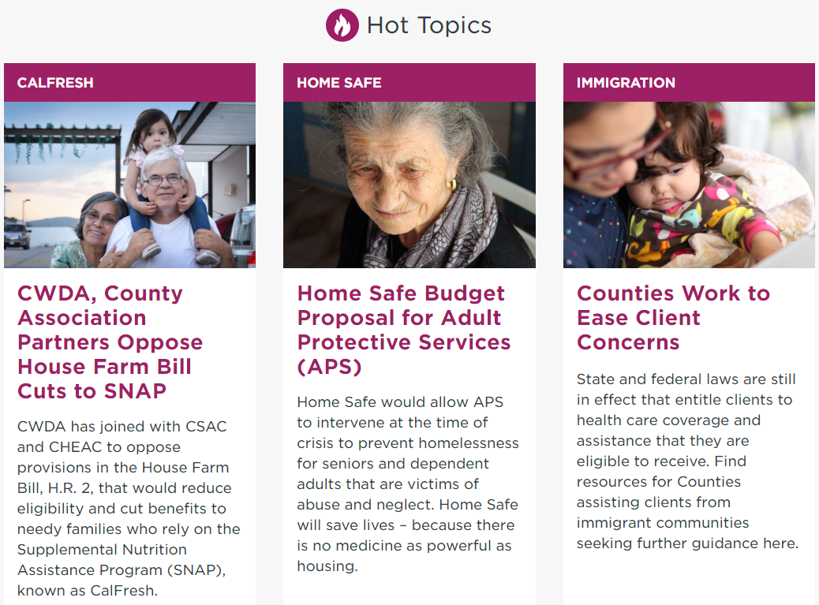
CWDA Immigration Toolkit
Toolkit link: https://www.cwda.org/post/immigration-resources
Where you can easily find the toolkit: CWDA home page
5

Slide 6
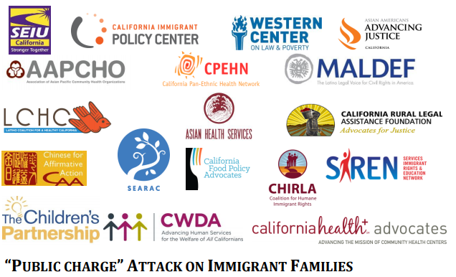
CWDA Immigration Toolkit
COUNTY RESOURCES
Joint CWDA Fact Sheet
Coming Soon:
  Q&A Public Charge Template
  Public Charge Infographic

Slide 7
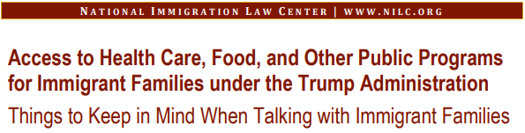

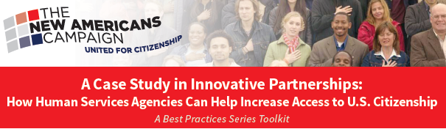

CWDA Immigration Toolkit
RESOURCES DEVELOPED BY PARTNER ORGANIZATIONS

Slide 8



CWDA Immigration Toolkit
CLIENT RESOURCES
Immigrant Health Fact Sheet: Is It Safe to Use Medi-Cal?
Family Preparedness Plan
Video: Public Charge & Proposed Changes

Slide 9
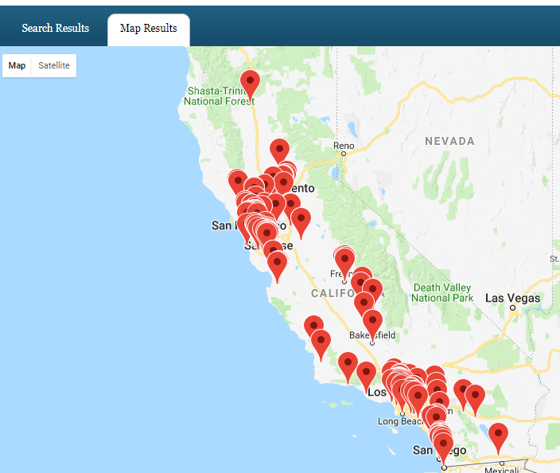


CWDA Immigration Toolkit
LEGAL RESOURCES
9
Notes:
9

Slide 10

Assisting Immigrant Families
Gabrielle Lessard, Lessard@nilc.org
This Photo by Unknown Author is licensed under CC BY-SA

Slide 11

Who We Are
National Immigration Law Center (NILC)
Our mission is to defend & advance the rights & opportunities of low-income immigrants and their family members.
We combine policy advocacy, impact litigation and strategic communications to protect immigrants’ rights and to advance their access to health care, education and economic opportunity.

Slide 12
Disclaimers
Things are changing fast!
There are a lot of unknowns.
We are sharing the information we have at this time.
We are providing general information and not legal advice.
  Consult with an attorney who can advise your organization about your specific situation.
12
Notes:
12

Slide 13
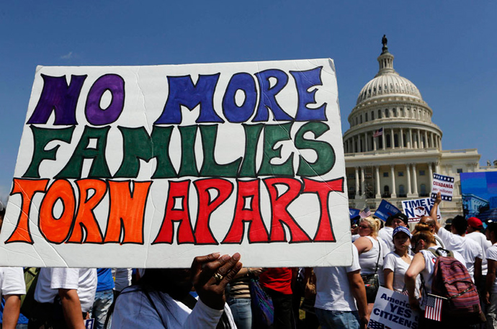
Community Concerns
13

Slide 14
The Current Environment
The Administration has made a series of policy decisions that limit immigration and make life more difficult for immigrant families in the U.S.
Implications - Chilling effect in accessing healthcare and other services
  People are afraid to come to appointments
  People asking to be dis-enrolled from WIC, Medi-Cal, and other programs
  People with status are afraid it will be taken away
14
Notes:
From it’s earliest days the Administration has made policy decisions adverse to the interests of immigrant families, beginning with Executive Orders that mandated stepped up immigration enforcement just days after inauguration, continuing with reductions in refugee admissions, the end of DACA and TPS protections and most recently the policy of separating immigrant families.

Slide 15
Current Enforcement Practices
Substantial increase in immigration arrests
  Especially arrests of people with no criminal convictions
ICE is engaging in the following enforcement practices:
  Going to homes and workplaces to arrest people, both in individual actions and through workplace raids.
  Making “collateral” arrests - arresting people who happen to be in a place where they are looking for someone else.
  Arresting people at ICE check-ins and USCIS appointments
15

Slide 16
Limits to enforcement: ‘sensitive locations’
Enforcement at or near ‘sensitive locations’ violates policy
  schools and other educational institutions
  hospitals and other health facilities
  places of worship
  the site of a funeral, wedding, or other public religious ceremony; and
  a site during the occurrence of a public demonstration, such as a march, rally or parade.
  not included: other social services, courts
Exceptions: exigent circumstances, prior supervisory approval

Slide 17
SB 54: California Values Act
Limits state/local entanglement in federal immigration enforcement
AG model policies for schools, libraries, state/local health facilities, courthouses, Labor Commissions, Agriculture labor relations board, workers’ comp, shelters - to ensure they remain safe and accessible to all residents;
  schools/health facilities “shall” implement model policy or equivalent;
  other orgs encouraged to adopt model policy
Notes:
Recognizes that local law enforcement participation in immigration enforcement undermines community trust. Limits within scope of federal law. Prohibits police departments from entering into agreements under 287(g) of INA, deputy ICE agents, prohibits ICE holds, found unconstitutional by multiple courts, limits notifications of release dates to serious crimes

Slide 18
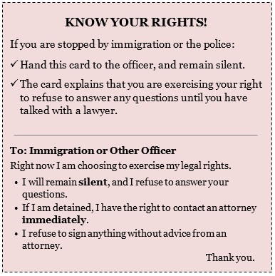
Individual Right During an Encounter with ICE
Individuals can:
refuse to answer questions until they have had a chance to consult with an attorney
choose not to speak at all by saying “I want to remain silent”
decline to share information about where they were born or how they entered the United States
carry a “know your rights” card and provide it to immigration officers if stopped
People should never run, or give false information!
18
Notes:
Everyone has constitutional rights, regardless of their immigration status
18

Slide 19

Confidentiality

Slide 20
Privacy Laws
Federal and state laws limit:
  inquiries about and collection of sensitive personal information;
  the information that may be verified; and
  The use and disclosure of information about benefit applicants or recipients for purposes other than determining eligibility or administering the program.
Laws cannot be changed by the Executive branch alone!

Slide 21
California W&I Code 10500:
Every person administering aid under any public assistance program shall conduct himself with courtesy, consideration, and respect toward applicants for and recipients of aid under that program, and shall endeavor at all times to perform his duties in such manner as to secure for every person the amount of aid to which he is entitled, without attempting to elicit any information not necessary to carry out the provisions of law applicable to the program, and without comment or criticism of any fact concerning applicants or recipients not directly related to the administration of the program.

Slide 22

Message for Consumers
The information you provide is confidential and can only be used to determine your eligibility.
You should apply for benefits for which you are eligible and get the services your family needs.

Slide 23
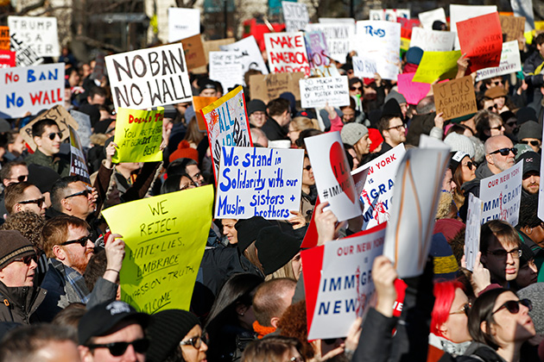
What’s Next: Public Charge
23
Notes:
23

Slide 24
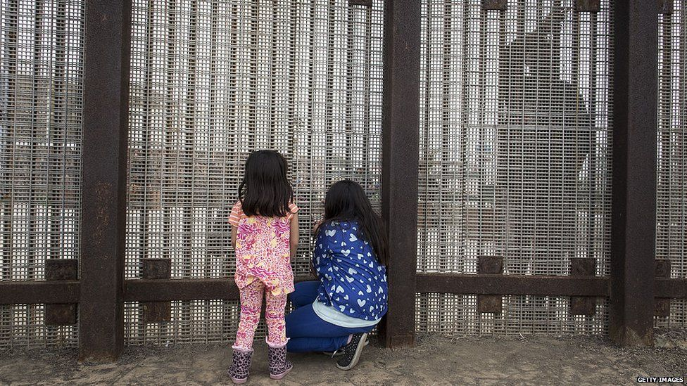
Public Charge: Background
Public Charge is a person who is “primarily dependent on the government for subsistence.” A person found likely to become a public charge may be denied:
  Admission to the US
  Lawful permanent residence (LPR, a green card)

Slide 25

“Totality of the Circumstances”
The public charge test considers multiple factors, including at a minimum, the person’s:
  Age
  Health
  Financial resources
  Family status
  Education and skills
Affidavit of support, and other relevant factors may be considered
No single factor is dispositive!

Slide 26

Public Charge: Benefits
Under longstanding policy, only two types of benefits have been considered in a public charge assessment:
  Cash assistance for income maintenance and
  Institutionalization for long-term care at government expense
  A forward looking test: Is the person likely to rely on cash or long-term care in the future?

Slide 27
Exemptions
Many immigrants are exempt from Public Charge:
  Refugees
  Asylees
  survivors of domestic violence, crime, or trafficking
  special immigrant juveniles
  other “humanitarian” immigrants
  also
  LPRs applying for citizenship are not subject to public charge.

Slide 28
Recent Changes
Foreign Affairs Manual (FAM)
28
Notes:
28

Slide 29
Foreign Affairs Manual (FAM) Changes
Officials in consulates abroad use the FAM to make decisions about whether to grant permission to enter the U.S.
Revisions to FAM instructions (Jan. 2018)
Public charge definition not changed, but:
  Affidavit of support is not enough on its own.
  Look to applicant’s age, health, family status, financial resources, skills
  Use of benefits may be considered as part of “totality of circumstances”
  May consider benefits used by sponsors or family members
NOTE: Affects only decisions made by consular officials abroad

Slide 30

Foreign Affairs Manual (FAM) Impact?
Impact so far?
  Some reports of denials or requests for evidence
  more scrutiny of affidavits of support by joint sponsors
  questions about employment/income, people with disabilities.
But:
  Forms for applicants and sponsors have NOT changed.
  FAM could be revised again, e.g. if policy for officials in US changes.
  We are monitoring this – please let us know what you hear!

Slide 31
PROPOSED CHANGES
Notice Of Proposed Rulemaking (NPRM)

Slide 32
Proposed Rules: Leaked Draft
USCIS is drafting proposed rules that would change the public charge test dramatically.
Draft leaked in Washington Post (3/28/18).
Under that draft, a “public charge” would be any person who uses or receives, or is likely to use or receive, one or more public benefit(s)
“Public benefit” would include cash or non-cash assistance that is means-tested or meant to assist with basic living necessities, such as housing, health care, utilities, nutrition.

Slide 33
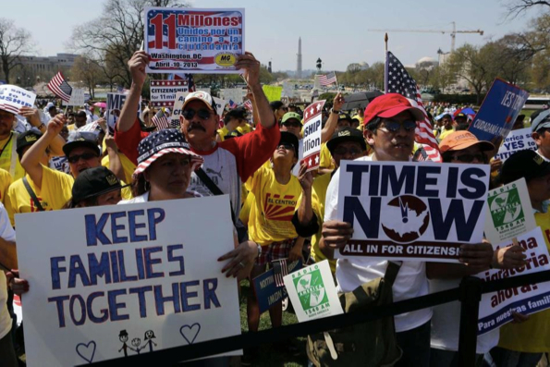
Public Charge – Proposed Changes
Draft proposed rule would consider almost any income-based benefits used by the applicant or a family member, including:
  Medi-Cal, Covered California subsidies
  CalFresh, WIC
  Refundable portion of EITC
  housing programs, energy assistance
And potentially many other programs not listed as exempt

Slide 34
Proposed changes: Exempt benefits
Benefits not considered under the leaked draft include:
  Earned benefits like Social Security, Medicare, Unemployment, workers compensation, SDI, government pensions
  Emergency and disaster relief
  Emergency Medi-Cal, testing/treatment of communicable diseases, homeless shelters, soup kitchens, domestic violence shelters
  Public education, school nutrition, Head Start, student loans

Slide 35
Leaked draft would weigh:
Age:18-61 considered “working age”
Health: Health conditions, unsubsidized health insurance
Assets and resources: Assets that can be converted to cash within 12 months
Education and skills: Ability to maintain full-time employment, educational levels, English proficiency
Financial status: Income above 250% of Federal Poverty Level, Application or receipt of public benefits, immigration fee waivers, credit reports/scores

Slide 36

Leaked Draft: Not Retroactive!
Under the leaked draft, benefits:
  that are currently excluded from the public charge test and
  received before the proposed rule is finalized
Will not be considered in the public charge determination

Slide 37

Hypothetical - Angie
Angie has three children. She came to the US on a student visa and later married a US citizen. She is applying for lawful permanent resident status.
  She completed her nursing degree, and has an offer to work for a hospital.
  Her spouse is working but they are struggling - with just one income.
  Their children are covered under Medi-Cal and get school lunch.
  Angie’s sister, who works at Google, is willing to sign a joint affidavit of support.

Slide 38

ANGIE
Negative factors
Several children
Low Income
Children on Medi-Cal
Positive Factors
Working age
Good health
Job offer
Skills are in demand
Sponsor

Slide 39
Things to Keep in Mind
Some immigrants are NOT subject to public charge
This is only a proposal. If it becomes final, non-cash benefits used before that time probably won’t be counted.
Negative and positive factors are balanced. A person with a negative factor may be able to overcome it by showing positive factors.
Each situation is different. People with questions should consult an immigration attorney about their individual case.
Fight back! Let the government know that this rule would harm you, your family, community and the country.

Slide 40
Timing - The Rulemaking Process
USCIS filed draft proposed regulations at the Office of Management and Budget (OMB). The draft will be revised after other federal agencies provide feedback.
A Notice of Proposed Rulemaking (NPRM) then will be posted in the Federal Register
  The public will have a chance to comment on the proposed rules.
  USCIS must respond to the comments before the regulations are finalized.

Slide 41
Protecting Immigrant Families Campaign
Protecting Immigrant Families, Advancing Our Future Campaign
Focus: defending and protecting access to health care, nutrition assistance, and other supports for low-income immigrants and their families
  Co-chaired by NILC and CLASP
  Steering committee includes immigrants’ rights organizations, national health consumer, anti-hunger, and health care providers
Sign up at: Bit.ly/pifcampaign
Notes:
Response to public charge and in the future

Slide 42
Share Stories/Document Harm
Document the harm to individuals, families, communities, and the benefits of investing in services. Stories can help educate federal agencies, elected officials, the media and the public.
You can enter information at http://action.nilc.org/page/s/protectfamilies-stories or send a short email to Kat Lundie at lundie@nilc.org. Explain why access to benefits or programs is essential for the person or family, a brief summary of the family’s immigration story, and the best way to reach you or them to follow up.

Slide 43
Resources
  Protecting Immigrant Families Campaign Resources
  Fact sheet on proposed changes to public charge
  Fact sheet on changes to the Foreign Affairs Manual (FAM)
  “Things to Keep in Mind When Talking with Immigrant Families” in light of the leaked draft NPRM and changes to the FAM
  Kaiser Family Foundation: Proposed Changes to Public Charge Policies for Immigrants: Implications for Access to Health Care
  Questions: publiccharge@nilc.org
  National Immigration Law Center: www.nilc.org

Slide 44
In Conclusion
Toolkit link: https://www.cwda.org/post/immigration-resources
Assmaa Elayyat aelayyat@cwda.org
Megan Gamble mgamble@cwda.org
CWDA will continue to update materials, including templates, as new information becomes available
In Conclusion
44

Slide 45
Questions?
45
45
Notes:
45

Slide 46
46

